Slide 1
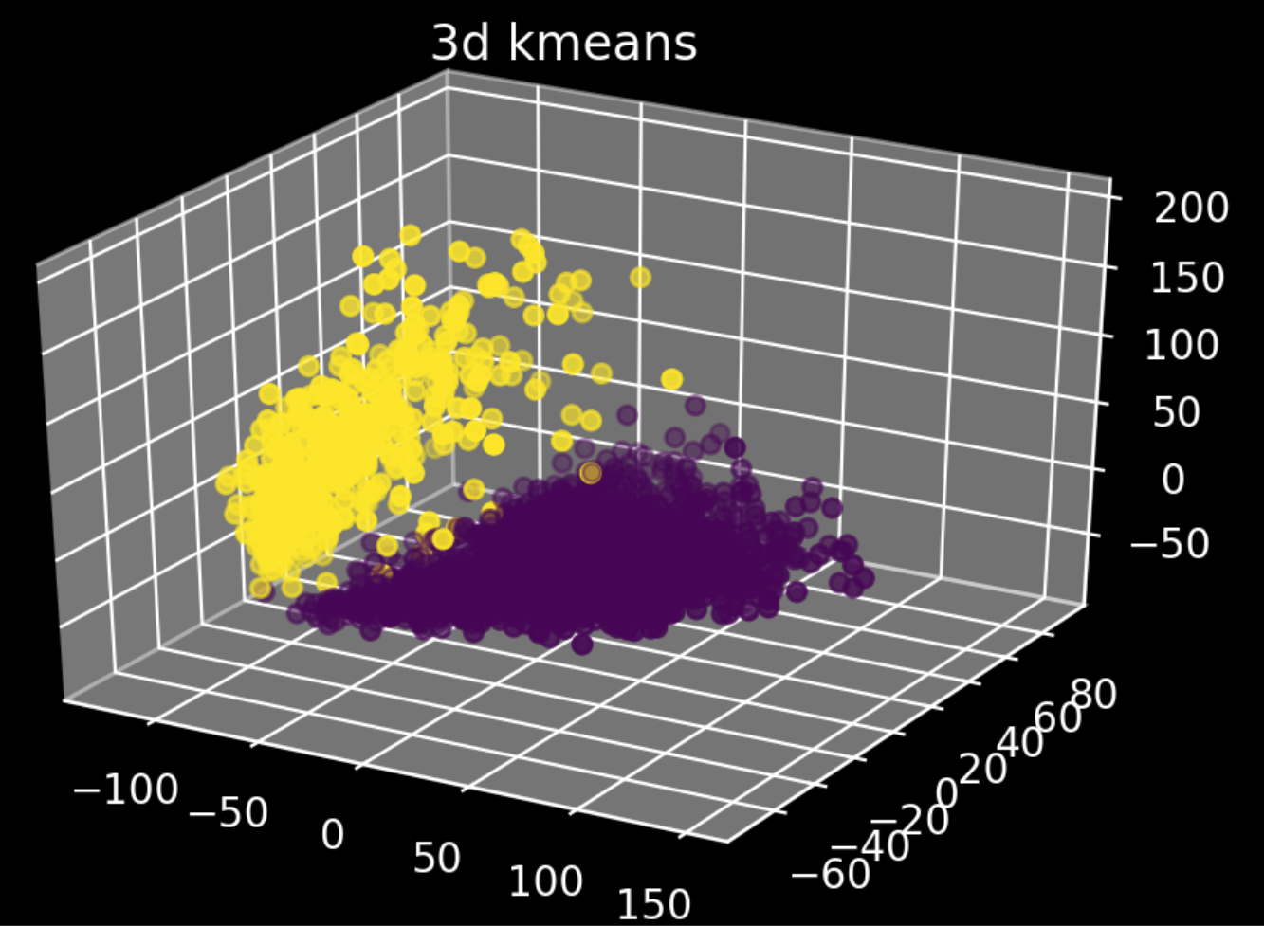
K-means clustering project proposal
Data analysis project 4, group 2

Slide 2
Table of contents
Information on the dataset
Filtering of data
Progress and results
Future plans

Slide 3
3K PBMCs from a healthy donor
By 10x Genomics
Contains single cell gene expression data
Dimensions: 2700 cells, ~32700 genes
PBMCs (Peripheral blood mononuclear cells):
T cells
B cells
NK cells
Monocytes
Data was obtained using Illumina NextSeq500

Slide 4
Filtering
Raw data
2700
32700
Removal of cells that were not expressed in any cells
2700
16600
Removal of outliers by Isolation forest algorithm (optional)
2430
n
PCA
2700
n

Slide 5
